Slide 1
SS ZG 526: Distributed Computing
Internet of Things (IoT)
Chittaranjan Hota
Professor, Dept. of Computer Sc. & Information Systems
BITS, Pilani Hyderabad Campus, Hyderabad
hota@hyderabad.bits-pilani.ac.in

Slide 2

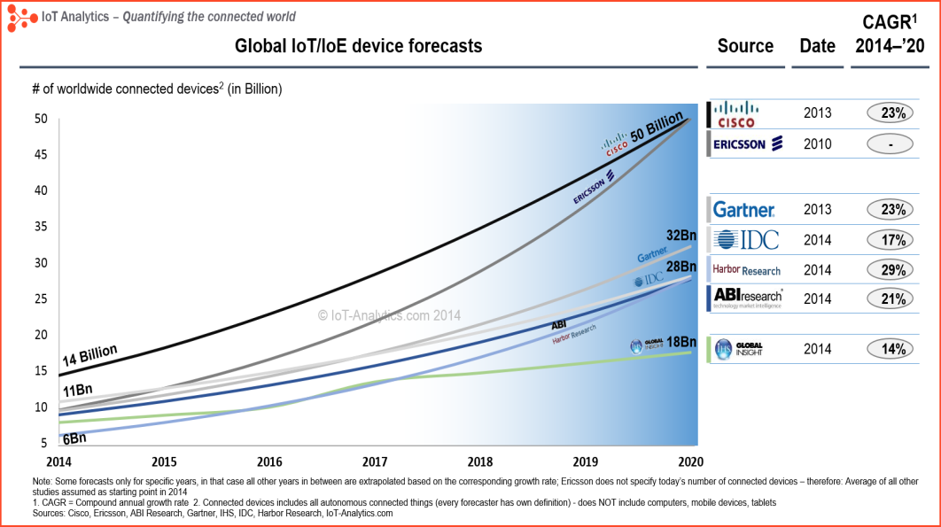
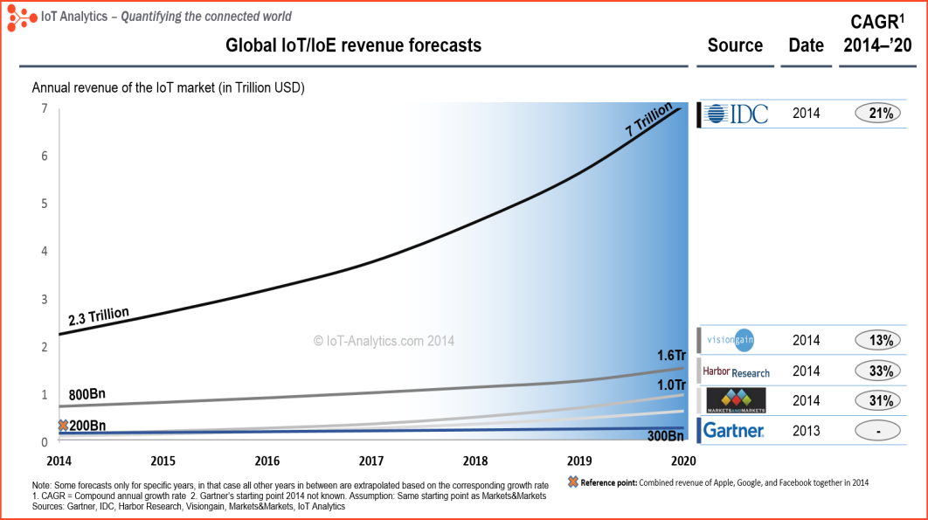
Internet of Things (IoT)
Devices, data, connections, processes and people are connected to the Internet in real time creating an ecosystem of smart devices acting upon all the bits of data that make up our daily life.
First used by Kevin Ashton in 1999.
Source: http://iot-analytics.com/iot-market-forecasts-overview/
Birla Institute of Technology and Science, Pilani (Deemed University)

Slide 3

IoT Architecture
Application Layer
Merchandise Tracking
Environment Protection
Intelligent Search
Tele-
medicine
Intelligent Traffic
Smart Home
Cloud Computing Platform
Network Layer
The
Internet
Information
Network
Mobile Telecom Network
RFID
Sensor Network
GPS
Sensing Layer
RFID Label
Sensor Nodes
Road Mapper
Birla Institute of Technology and Science, Pilani (Deemed University)

Slide 4

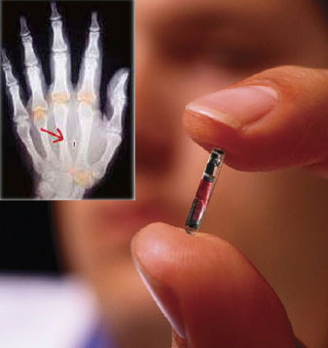
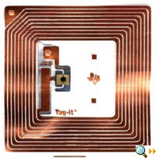
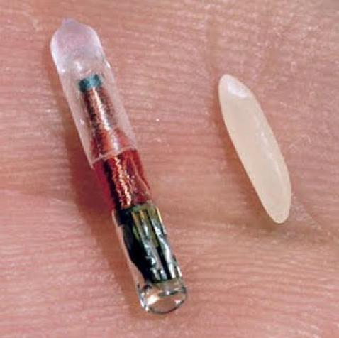
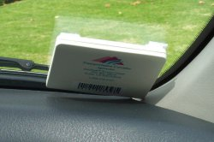
RFID : Radio Frequency IDentification Technology
RFID refers to small electronic devices that consist of a small chip and an antenna.
Chip typically can carry 2,000 bytes of data or less.
RFID chip next to a grain of rice. This chip contains a radio-frequency electromagnetic field coil that modulates an external magnetic field to transfer a coded identification number when queried by a reader device. This small type is incorporated in consumer products, and even implanted in pets, for identification.
An RFID tag used for electronic toll collection.
http://en.wikipedia.org/wiki/Radio-frequency_identification

Slide 5
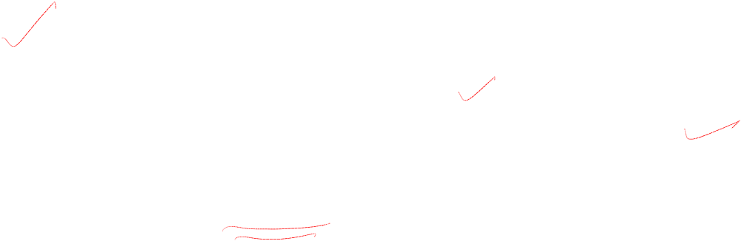
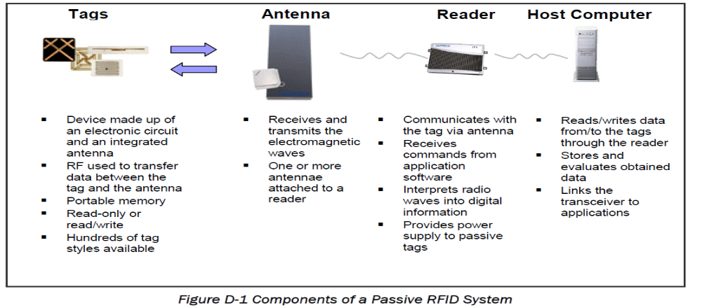
RFID Technology

Slide 6
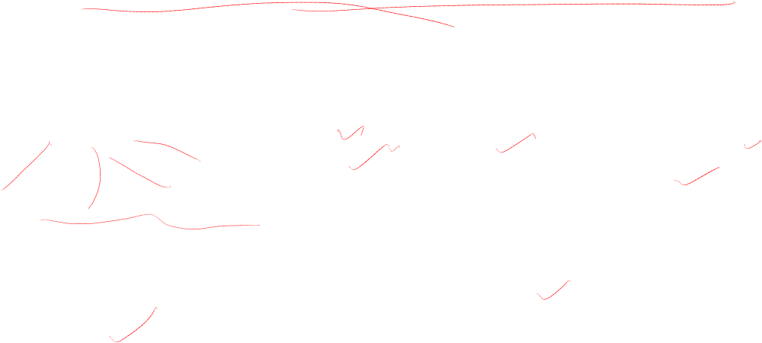
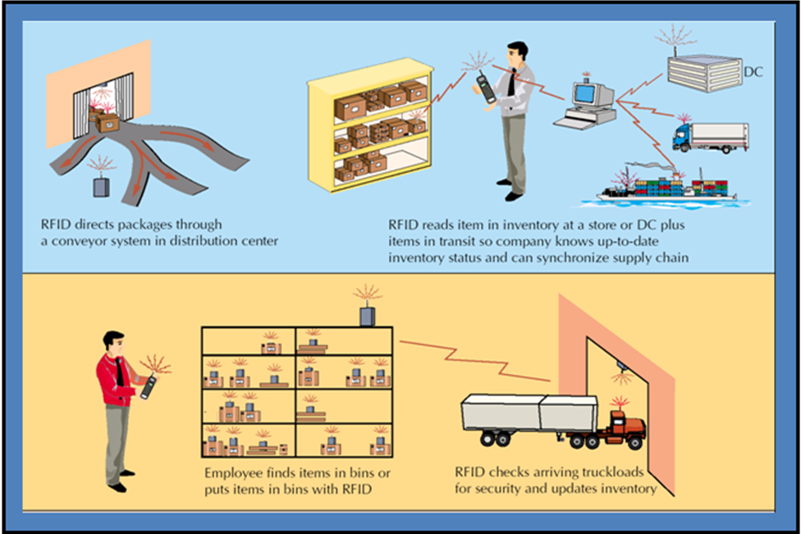
RFID Merchandize Tracking in Distribution Center

Slide 7
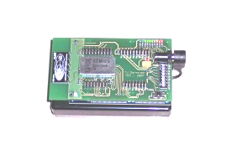
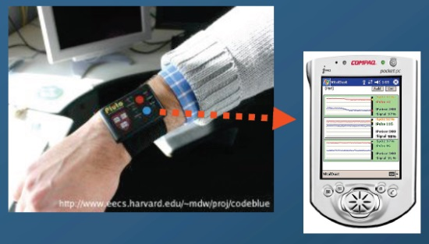
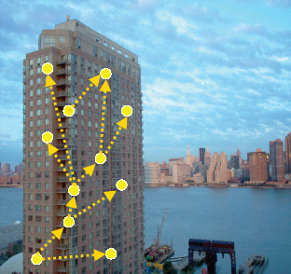
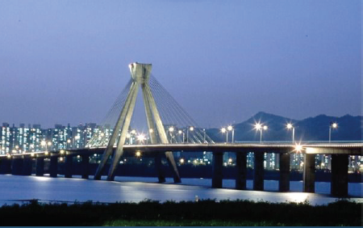
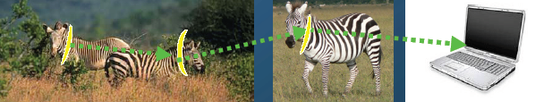

What is a Wireless Sensor Network?
Self-organizing networks formed by many autonomous sensor nodes
  Each node comprises its own power supply, processing unit, radio and sensors
  Typically peer-to-peer communication (no central server)
  Many (100 to 10,000) sensor nodes per net
Various Applications: Industrial Automation, Building Control, Health Care, Military, Farming, Traffic Control, Home Automation, ...
Notes:
|
| <number>
„Smart“ und „Ambient“ im letzten Punkt bilden die Überleitung zu den neuen Folien, wo „Intelligent System“ beschrieben wird.

Slide 8




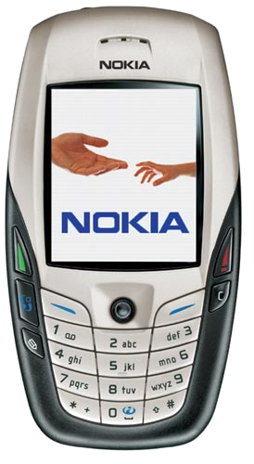
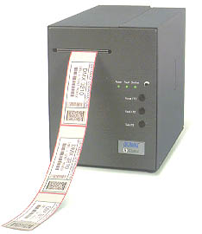

Use Case : Cinema Example
STEP 1:
Environment with ZigBee node
Step 3:
The users with SIMTOOLKIT application buy the content. The operator manages the bill transaction and downloads the token to the SIM
for enabling the access to the cinema
DB
Cinema
GPRS/UMTS
STEP 2:
User having Z-SIM is recognized by the environment and is invited to buy a cinema ticket
Encrypted SMS
Do you
confirm the
purchase of
“La fabbrica di
cioccolato”?
Step 4:
The token is received and sent to the printer via ZigBee
The ticket is automatically printed

Slide 9
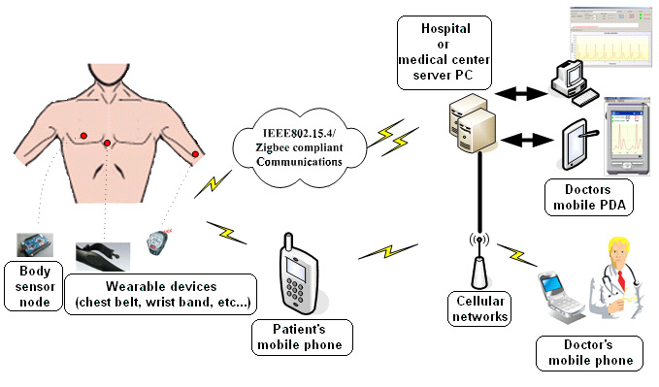
IoT Telemedicine Applications:
Patient Data Transferred Using a Wireless Sensor Network.
(Courtesy of Inftech, 2007)

Slide 10
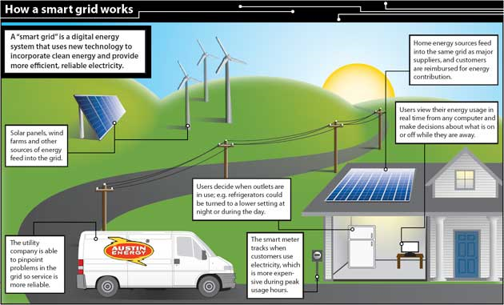

Smart Power Grid

Slide 11
Thank You!
Birla Institute of Technology and Science, Pilani (Deemed University)

